Slide 1
ePerformance
Human Resources

Slide 2
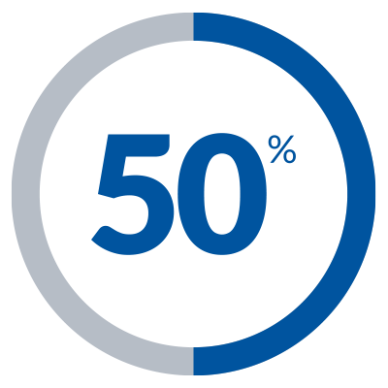
SHRA Key Policy Elements
April
March
3 = Exceeds Expectations
2 = Meets Expectations
1 = Not Meeting Expectations
1
31
5 Standard Institutional Goals
3-5 Individual SMART Goals
Compliance & Integrity
Customer-Oriented
Team-Oriented
Expertise
Supervisor
(as needed)
Accountability
%
Notes:
Who is seeing this for the first time? Who was not here a year ago and is new to this process?
For those who this is not new explain that all of these elements are now incorporated into the new performance plan
Dates, Ratings, Weights and Goals

Slide 3
EHRA Key Performance Elements
July
June
3 = Exceeds Expectations
2 = Meets Expectations
1 = Not Meeting Expectations
1
30
3-5 Individual SMART Goals
Development Goals
Notes:
Who is seeing this for the first time? Who was not here a year ago and is new to this process?
For those who this is not new explain that all of these elements are now incorporated into the new performance plan
Dates, Ratings, Weights and Goals

Slide 4
Benefits
Fast
Easy
Paperless
Notes:
Real time interaction between employee and supervisor ***pull language from the senior level presentation***
Intuitive and easy to follow instructions
No more paper! All files are kept within the program and can be accessed with a button click

Slide 5
Features
Linked
Intuitive
Overview
Notes:
Linked to job descriptions ***It is important to understand that our information is only as good as banner. If you have any personnel changes please update them in banner as soon as possible as it is the system of record.
easy tabs and drop down menus
allows designated users to add co-reviewers
email notifications to meet deadlines
Allows you to see the overview of any supervisor or employee review
built in auto calculations of overall ratings

Slide 6
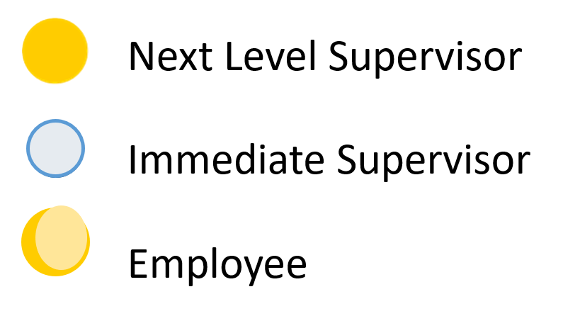
SHRA Plan Process
Immediate Supervisor and Employee Create the Performance Plan
Next Level Supervisor Approves the Performance Plan
Performance Plan Review Meeting with Employee
Employee Acknowledges Performance Plan
Notes:
SHRA 10 Step process
Immediate Supervisors 5 steps
Next level Supervisors 2 Steps

Slide 7
EHRA Plan Process
Immediate Supervisor and Employee Create the Performance Plan
Performance Plan Review Meeting with Employee
Employee Acknowledges Performance Plan
Notes:
SHRA 10 Step process
Immediate Supervisors 5 steps
Next level Supervisors 2 Steps

Slide 8
Exempt from Appraisal Process
SAAO Tier I
Faculty
Post-Doctoral Scholars
Athletic Directors
Head Coaches
Assistant/Associate Coaches
Notes:
SHRA 10 Step process
Immediate Supervisors 5 steps
Next level Supervisors 2 Steps

Slide 9
 | Action Items (Steps) Timeline SHRA | Open Date | Due Date
1 | Supervisor Creates the Plan | 4/1/2018 | 5/30/2018
2 | Next Level Supervisor Approval | 4/1/2018 | 5/30/2018
3 | Plan Review Meeting | 4/1/2018 | 5/30/2018
4 | Employee Acknowledgement of Plan | 4/1/2018 | 5/30/2018
5 | Mid-Year Check-In | 10/1/2018 | 10/31/2018
6 | Employee Acknowledgement of Mid-Year | 10/1/2018 | 10/31/2018
7 | Supervisor Appraisal | 3/1/2019 | 4/30/2019
8 | Next Level Supervisor Approves the Appraisal | 3/1/2019 | 4/30/2019
9 | Appraisal Meeting | 3/1/2019 | 4/30/2019
10 | Employee Acknowledgement of Appraisal | 3/1/2019 | 4/30/2019
Notes:
The supervisor can make comments for edits or recommendations and send back the plan/appraisal if necessary
Ensure that all weights equal 100% 3-5 individual goals are related to job description
Provide examples

Slide 10
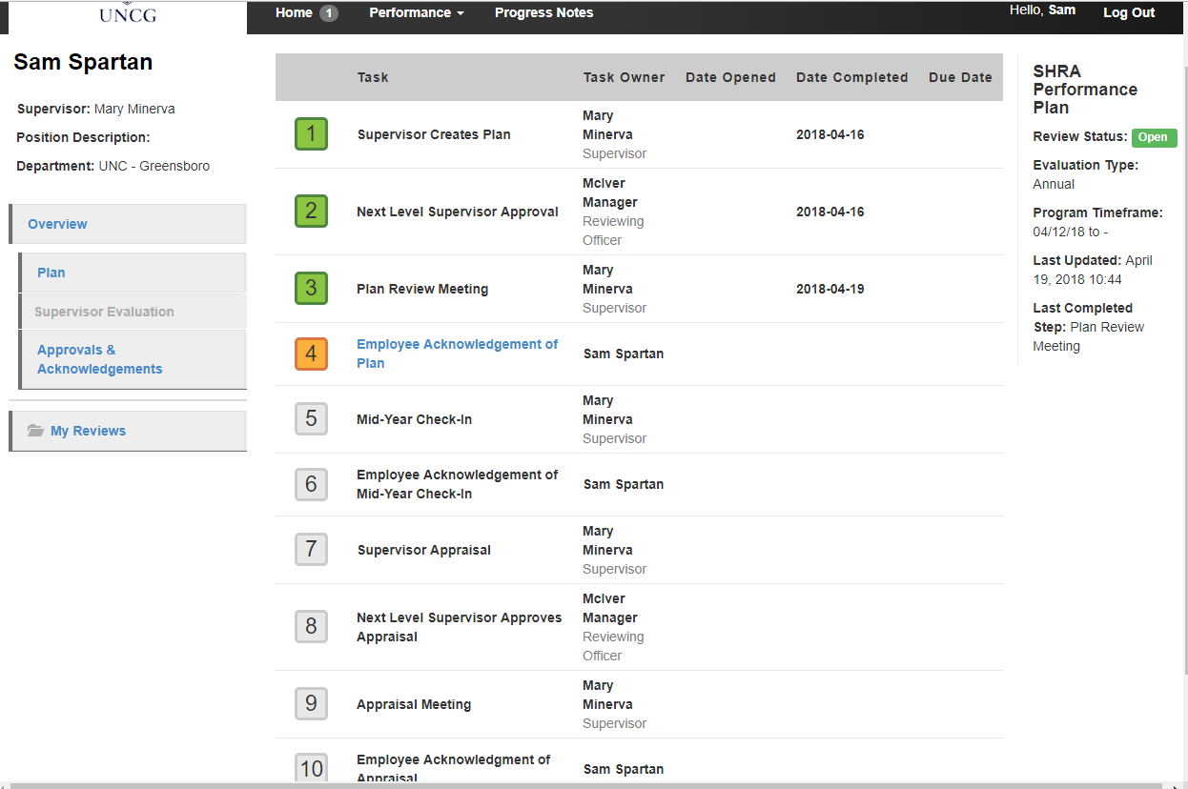
SHRA Task Steps
Notes:
SHRA 10 Step process
Immediate Supervisors 5 steps
Next level Supervisors 2 Steps

Slide 11
 | Action Items (Steps) Timeline EHRA | Open Date | Due Date
1 | Supervisor Creates the Plan | 7/1/2018 | 8/31/2018
2 | Plan Review Meeting | 7/1/2018 | 8/31/2018
3 | Employee Acknowledgement of Plan | 7/1/2018 | 8/31/2018
4 | Supervisor Appraisal | 5/1/2019 | 6/30/2019
5 | Next Level Supervisor Approves the Appraisal | 5/1/2019 | 6/30/2019
6 | Appraisal Meeting | 5/1/2019 | 6/30/2019
7 | Employee Acknowledgement of Appraisal | 5/1/2019 | 6/30/2019
Notes:
The supervisor can make comments for edits or recommendations and send back the plan/appraisal if necessary
Ensure that all weights equal 100% 3-5 individual goals are related to job description
Provide examples

Slide 12
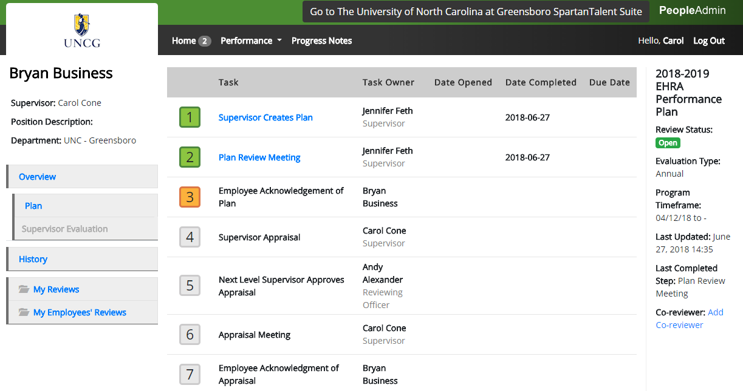
EHRA Task Steps
Notes:
SHRA 10 Step process
Immediate Supervisors 5 steps
Next level Supervisors 2 Steps

Slide 13
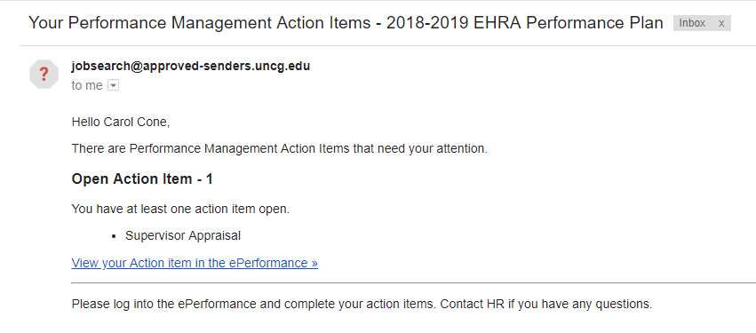
Email Notifications
Notifications are sent once a day

Slide 14
Resources
Information is available on hrs.uncg.edu/Performance_Management
You can find:
Policies
Goal Guidance Tables
Supervisor Guides
Quick Start Reference Guides
Frequently Asked Questions
SpartanTalent Problem Form

Slide 15
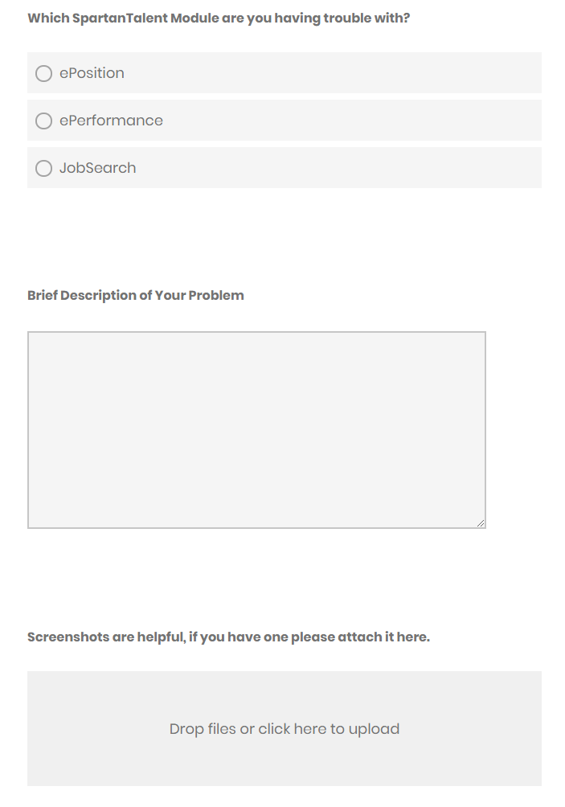
SpartanTalent Problem Form
Commonly Reported Issues
Missing Employee
Incorrect Supervisor
Duplicate Employee Listings
Reopening of Completed Tasks
General Questions

Slide 16
Contacts
Jenn Feth
jmfeth@uncg.edu
336-334-4508
Gwen Evans, Director
gevans@uncg.edu
336-334-4512
Rowena Cassim-Sims, HRBP
rjcassim@uncg.edu
336-334-9724
Contact Us
Marlon Summers, HRBP
mdsumme2@uncg.edu
336-334-9855
SpartanTalent Problem Form
Notes:
https://uncg.qualtrics.com/jfe/form/SV_7WIuplFY03m69w1
Call it the Spartan Talent Problem Form

